Slide 1
HSOY51S1-2020US KATO NA: Evaluation of different SYN550023 formulations for grass efficacy and crop safety LPOST
Holloway, James
Vaz Da Silva, Joao Renato, Eric Palmer
2020 Crop Protection Field Development
Last Updated: AUG-26-2020

Slide 2
Acknowledgements and Test Locations:
Trial | State | Cooperator/ Syngenta Rep | IH/ CRO/ COI | Target | Data was available for the summary presentation (Y/N) | Data was used to answer the protocol objective(s) (Y/N)
USEB0H1222020 | MD | Hitchner, Erin | IH | LLGT Corn; DIGSA; SETFA | Y | Y
USND0H0392020 | KS | Nichols, Craig | IH | LLGT Corn; Enlist Corn; DIGSA; SETPU | Y | Y
USNE0H2202020 | IA | Moses, Adrian | IH | Enlist Corn; ECHCG; PANDI; SETFA | Y | Y
USSG0H0252020 | TN | Holloway, James | IH | LLGT Corn; Enlist Corn; BRAPP; ELEIN | Y | Y

Slide 3
Objectives:
Determine the optimum SYN550023 rate for each formulation that will provide acceptable control of key grasses LPOST
Determine the best SYN550023 formulation for grass efficacy and crop selectivity
How does SYN550023 compare to the standard clethodim for controlling larger grasses?

Slide 4
Treatment
Trt No. | Trt Name | Product Description | Lot Code | Conc. | Type | Rate | Other Rate | Code | Method | Timing | Placement
1 | CHECK | CHECK
2 | AMSOL | AMMONIUM SULFATE |  |  | SL | 2.5 % v/v | 2.5 % V/V | A | NONINC | POSPOS | BROFOL
2 | EXF17381 [E] | SYN550023 (200) GA/L | SYN550023 | 200 gA/L | EC | 25 g a/ha | 0.125 L/ha | A | NONINC | POSPOS | BROFOL
2 | ADDITIVE AGRIDEX | ADDITIVE AGRIDEX |  |  | SL | 1 % v/v | 1 % V/V | A | NONINC | POSPOS | BROFOL
3 | AMSOL | AMMONIUM SULFATE |  |  | SL | 2.5 % v/v | 2.5 % V/V | A | NONINC | POSPOS | BROFOL
3 | EXF17381 [E] | SYN550023 (200) GA/L | SYN550023 | 200 gA/L | EC | 50 g a/ha | 0.25 L/ha | A | NONINC | POSPOS | BROFOL
3 | ADDITIVE AGRIDEX | ADDITIVE AGRIDEX |  |  | SL | 1 % v/v | 1 % V/V | A | NONINC | POSPOS | BROFOL
4 | AMSOL | AMMONIUM SULFATE |  |  | SL | 2.5 % v/v | 2.5 % V/V | A | NONINC | POSPOS | BROFOL
4 | EXF17381 [E] | SYN550023 (200) GA/L | SYN550023 | 200 gA/L | EC | 75 g a/ha | 0.375 L/ha | A | NONINC | POSPOS | BROFOL
4 | ADDITIVE AGRIDEX | ADDITIVE AGRIDEX |  |  | SL | 1 % v/v | 1 % V/V | A | NONINC | POSPOS | BROFOL
5 | AMSOL | AMMONIUM SULFATE |  |  | SL | 2.5 % v/v | 2.5 % V/V | A | NONINC | POSPOS | BROFOL
5 | EXF17381 [E] | SYN550023 (200) GA/L | SYN550023 | 200 gA/L | EC | 100 g a/ha | 0.5 L/ha | A | NONINC | POSPOS | BROFOL
5 | ADDITIVE AGRIDEX | ADDITIVE AGRIDEX |  |  | SL | 1 % v/v | 1 % V/V | A | NONINC | POSPOS | BROFOL
6 | AMSOL | AMMONIUM SULFATE |  |  | SL | 2.5 % v/v | 2.5 % V/V | A | NONINC | POSPOS | BROFOL
6 | EXF19214 [J] | SYN550023 (250) GA/L | SYN550023 | 250 gA/L | EC | 25 g a/ha | 0.1 L/ha | A | NONINC | POSPOS | BROFOL
6 | ADDITIVE AGRIDEX | ADDITIVE AGRIDEX |  |  | SL | 1 % v/v | 1 % V/V | A | NONINC | POSPOS | BROFOL
7 | AMSOL | AMMONIUM SULFATE |  |  | SL | 2.5 % v/v | 2.5 % V/V | A | NONINC | POSPOS | BROFOL
7 | EXF19214 [J] | SYN550023 (250) GA/L | SYN550023 | 250 gA/L | EC | 50 g a/ha | 0.2 L/ha | A | NONINC | POSPOS | BROFOL
7 | ADDITIVE AGRIDEX | ADDITIVE AGRIDEX |  |  | SL | 1 % v/v | 1 % V/V | A | NONINC | POSPOS | BROFOL

Slide 5
Treatment
Trt No. | Trt Name | Product Description | Lot Code | Conc. | Type | Rate | Other Rate | Code | Method | Timing | Placement
8 | AMSOL | AMMONIUM SULFATE |  |  | SL | 2.5 % v/v | 2.5 % V/V | A | NONINC | POSPOS | BROFOL
8 | EXF19214 [J] | SYN550023 (250) GA/L | SYN550023 | 250 gA/L | EC | 75 g a/ha | 0.3 L/ha | A | NONINC | POSPOS | BROFOL
8 | ADDITIVE AGRIDEX | ADDITIVE AGRIDEX |  |  | SL | 1 % v/v | 1 % V/V | A | NONINC | POSPOS | BROFOL
9 | AMSOL | AMMONIUM SULFATE |  |  | SL | 2.5 % v/v | 2.5 % V/V | A | NONINC | POSPOS | BROFOL
9 | EXF19214 [J] | SYN550023 (250) GA/L | SYN550023 | 250 gA/L | EC | 100 g a/ha | 0.4 L/ha | A | NONINC | POSPOS | BROFOL
9 | ADDITIVE AGRIDEX | ADDITIVE AGRIDEX |  |  | SL | 1 % v/v | 1 % V/V | A | NONINC | POSPOS | BROFOL
10 | AMSOL | AMMONIUM SULFATE |  |  | SL | 2.5 % v/v | 2.5 % V/V | A | NONINC | POSPOS | BROFOL
10 | EXF18546 [H] | SYN550023 (500) GA/L | SYN550023 | 500 gA/L | SC | 25 g a/ha | 0.05 L/ha | A | NONINC | POSPOS | BROFOL
10 | ADDITIVE AGRIDEX | ADDITIVE AGRIDEX |  |  | SL | 1 % v/v | 1 % V/V | A | NONINC | POSPOS | BROFOL
11 | AMSOL | AMMONIUM SULFATE |  |  | SL | 2.5 % v/v | 2.5 % V/V | A | NONINC | POSPOS | BROFOL
11 | EXF18546 [H] | SYN550023 (500) GA/L | SYN550023 | 500 gA/L | SC | 50 g a/ha | 0.1 L/ha | A | NONINC | POSPOS | BROFOL
11 | ADDITIVE AGRIDEX | ADDITIVE AGRIDEX |  |  | SL | 1 % v/v | 1 % V/V | A | NONINC | POSPOS | BROFOL
12 | AMSOL | AMMONIUM SULFATE |  |  | SL | 2.5 % v/v | 2.5 % V/V | A | NONINC | POSPOS | BROFOL
12 | EXF18546 [H] | SYN550023 (500) GA/L | SYN550023 | 500 gA/L | SC | 75 g a/ha | 0.15 L/ha | A | NONINC | POSPOS | BROFOL
12 | ADDITIVE AGRIDEX | ADDITIVE AGRIDEX |  |  | SL | 1 % v/v | 1 % V/V | A | NONINC | POSPOS | BROFOL
13 | AMSOL | AMMONIUM SULFATE |  |  | SL | 2.5 % v/v | 2.5 % V/V | A | NONINC | POSPOS | BROFOL
13 | EXF18546 [H] | SYN550023 (500) GA/L | SYN550023 | 500 gA/L | SC | 100 g a/ha | 0.2 L/ha | A | NONINC | POSPOS | BROFOL
13 | ADDITIVE AGRIDEX | ADDITIVE AGRIDEX |  |  | SL | 1 % v/v | 1 % V/V | A | NONINC | POSPOS | BROFOL
14 | AMSOL | AMMONIUM SULFATE |  |  | SL | 2.5 % v/v | 2.5 % V/V | A | NONINC | POSPOS | BROFOL
14 | SELECT MAX 0.97 EC | CLETHODIM (116.23) GA/L |  | 116.23 gA/L | EC | 100 g a/ha | 0.86 L/ha | A | NONINC | POSPOS | BROFOL
14 | ADDITIVE AGRIDEX | ADDITIVE AGRIDEX |  |  | SL | 1 % v/v | 1 % V/V | A | NONINC | POSPOS | BROFOL

Slide 6
Results: Crop/Weed sizes at application
Trial | Application_Date | Crop | Pest | Crop_Pest_Min_Stage | Crop_Pest_Max_Stage | Crop_Pest_Majority_Stage | Crop_Pest_Min_Height | Crop_Pest_Max_Height | Crop_Pest_Height_Unit
USEB0H1222020 | 08-Jun-2020 | Soybean |  | 13 | 14 | 14 | 5 | 8 | IN
USEB0H1222020 | 08-Jun-2020 |  | Setaria faberi | 21 | 22 | 22 | 3 | 6 | IN
USEB0H1222020 | 08-Jun-2020 |  | Digitaria sanguinalis | 21 | 22 | 22 | 3 | 6 | IN
USEB0H1222020 | 08-Jun-2020 |  | Zea mays | 15 | 15 | 14 | 8 | 12 | IN
USND0H0392020 | 08-Jun-2020 |  | Zea mays | 14 | 15 | 15 | 10 | 12 | IN
USND0H0392020 | 08-Jun-2020 |  | Digitaria sanguinalis | 14 | 16 | 15 | 3 | 4 | IN
USND0H0392020 | 08-Jun-2020 | Soybean |  | 12 | 13 | 13 | 6 | 8 | IN
USND0H0392020 | 08-Jun-2020 |  | Setaria helvola | 12 | 14 | 13 | 3 | 4 | IN
USND0H0392020 | 08-Jun-2020 |  | Zea mays | 14 | 15 | 15 | 10 | 12 | IN
USNE0H2202020 | 16-Jun-2020 | Soybean |  | 14 | 14 | 13 | 9 | 10 | IN
USNE0H2202020 | 16-Jun-2020 |  | Zea mays | 15 | 16 | 15 | 14 | 15 | IN
USNE0H2202020 | 16-Jun-2020 |  | Portulaca oleracea | 13 | 15 | 13 | 3 | 5 | IN
USNE0H2202020 | 16-Jun-2020 |  | Panicum dichotomiflorum | 12 | 14 | 13 | 4 | 8 | IN
USNE0H2202020 | 16-Jun-2020 |  | Setaria faberi | 13 | 14 | 13 | 9 | 10 | IN
USNE0H2202020 | 16-Jun-2020 |  | Abutilon theophrasti | 11 | 13 | 12 | 6 | 10 | IN
USNE0H2202020 | 16-Jun-2020 |  | Amaranthus x tamariscinus | 12 | 13 | 13 | 3 | 9 | IN
USNE0H2202020 | 16-Jun-2020 |  | Chenopodium album | 16 | 18 | 17 | 5 | 12 | IN
USNE0H2202020 | 16-Jun-2020 |  | Echinochloa crus-galli | 13 | 13 | 12 | 2 | 4 | IN
USSG0H0252020 | 01-Jun-2020 |  | Zea mays Enlist | 14 | 14 | 14 | 10 | 10 | IN
USSG0H0252020 | 01-Jun-2020 |  | Brachiaria platyphylla | 19 | 19 | 13 | 2 | 4 | IN
USSG0H0252020 | 01-Jun-2020 | Soybean |  | 12 | 12 | 12 | 4 | 6 | IN
USSG0H0252020 | 01-Jun-2020 |  | Zea mays RR | 14 | 14 | 14 | 10 | 10 | IN
USSG0H0252020 | 01-Jun-2020 |  | Eleusine indica | 19 | 19 | 13 | 3 | 4 | IN
TARGET WEEDS:
• Volunteer corn (RR and/or Enlist): V6
• SETFA, ELEIN, ECHCG (as secondary targets) - 4 to 6 inches, 2 tillers

Slide 7
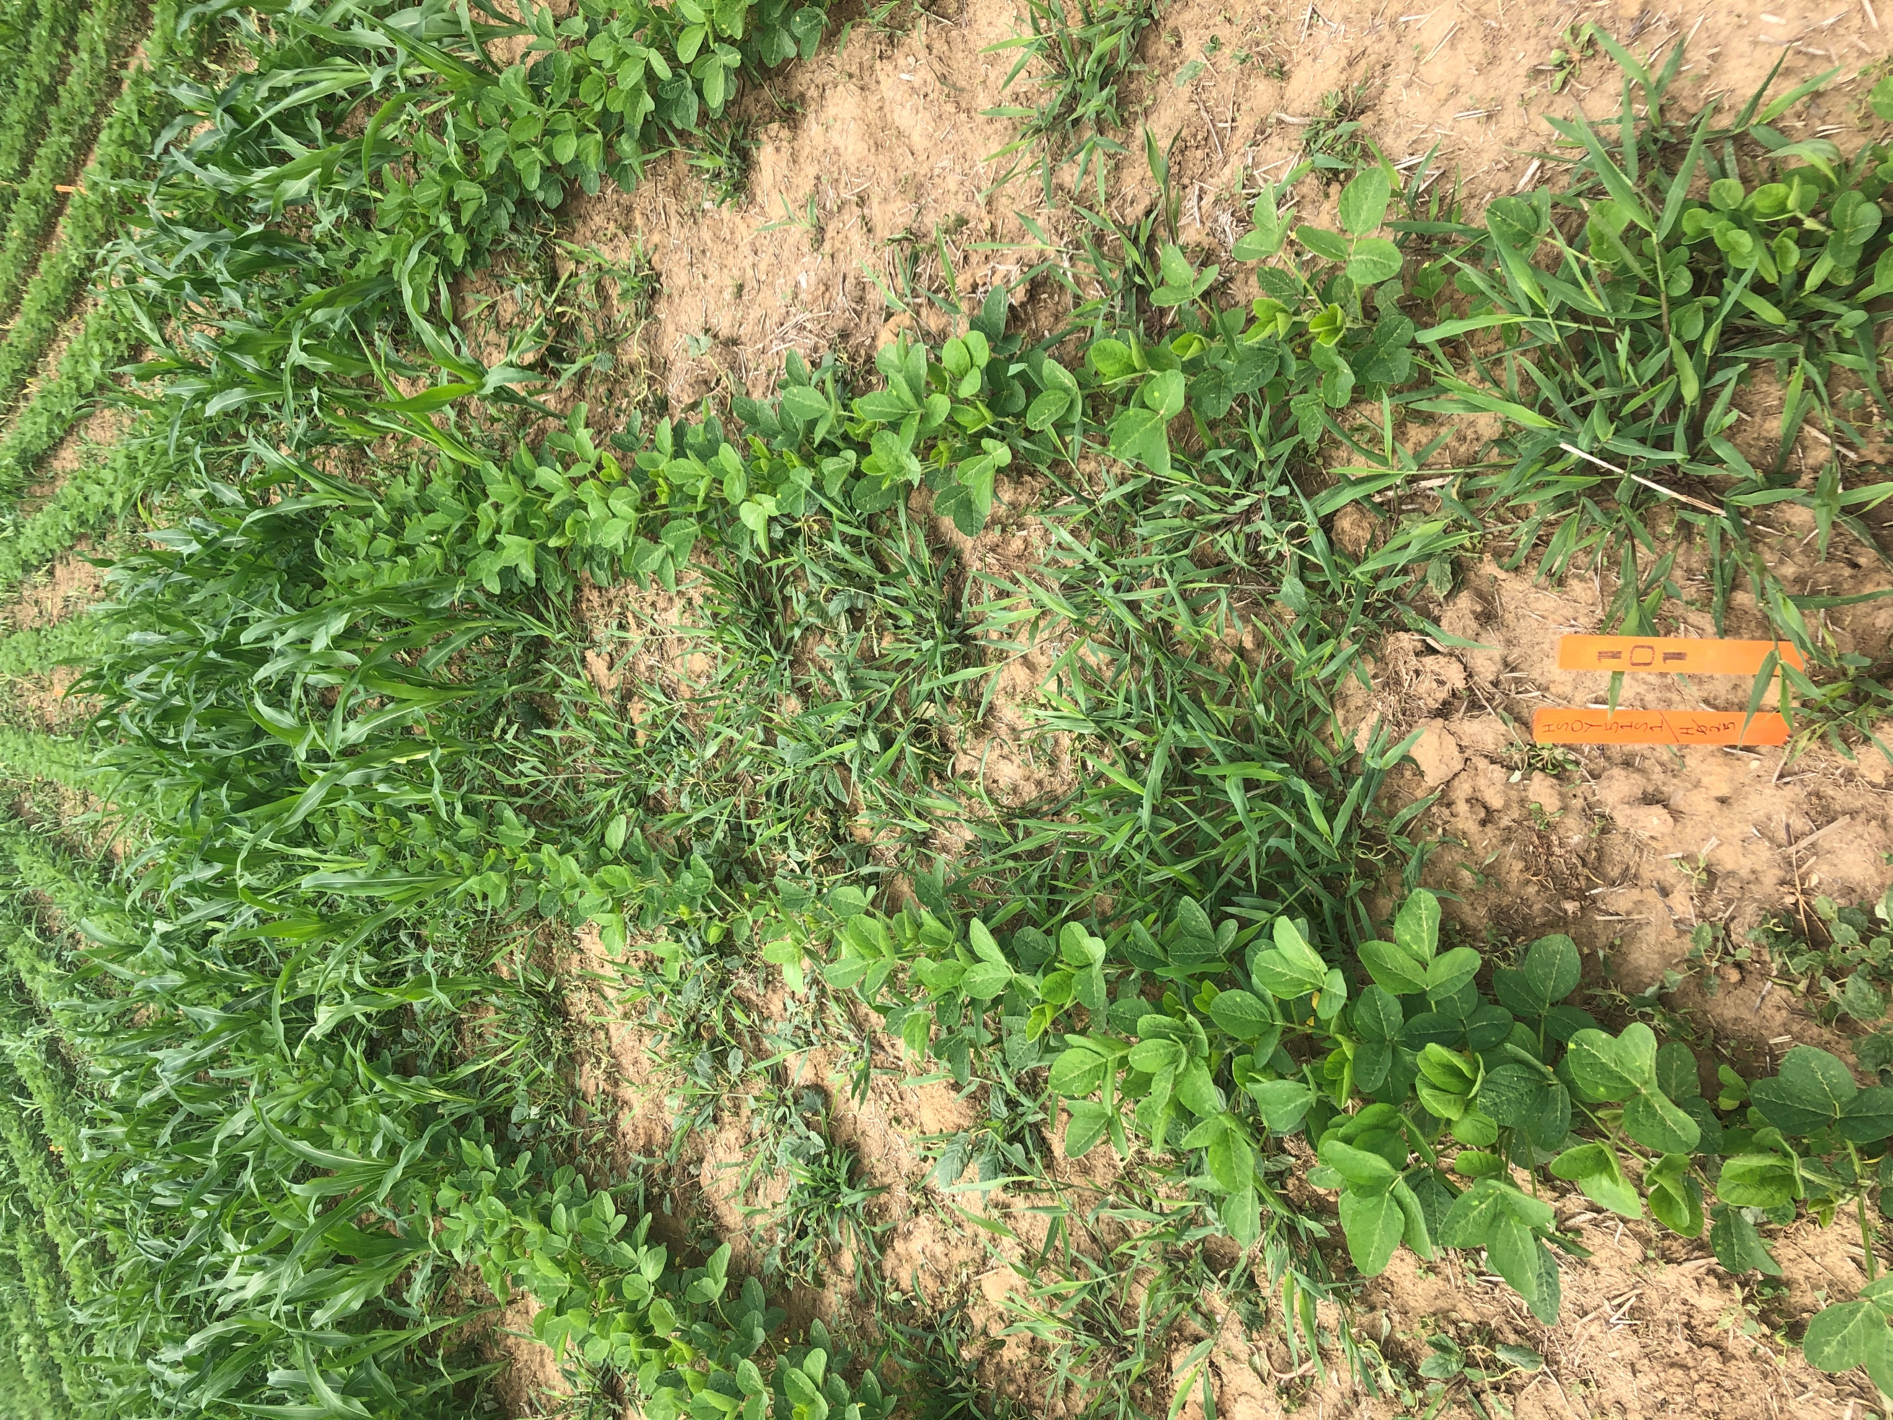
Layout TN location – Enlist and RRLL corn planted perpendicular to Enlist One Soybeans with an overlay of Enlist One 7 days before application to eliminate broadleaves
Enlist Corn row 3,4
RRLL Corn rows 1,2
ELEIN
BRAPP
Soybean S46-E3

Slide 8
Large Crabgrass Control (14 DAA)
All treatments had AMS 2.5% and COC 1%

Slide 9
Large Crabgrass Control (28 DAA)
All treatments had AMS 2.5% and COC 1%

Slide 10
Large Crabgrass Control (42 DAA)
All treatments had AMS 2.5% and COC 1%

Slide 11
Broadleaf Signalgrass Control (7 DAA)
All treatments had AMS 2.5% and COC 1%

Slide 12
Broadleaf Signalgrass Control (14 DAA)
All treatments had AMS 2.5% and COC 1%

Slide 13
Broadleaf Signalgrass Control (28 DAA)
All treatments had AMS 2.5% and COC 1%

Slide 14
Goosegrass Control (7 DAA)
All treatments had AMS 2.5% and COC 1%

Slide 15
Goosegrass Control (14 DAA)
All treatments had AMS 2.5% and COC 1%

Slide 16
Goosegrass Control (28 DAA)
All treatments had AMS 2.5% and COC 1%

Slide 17
Fall Panicum Control (14 DAA)
All treatments had AMS 2.5% and COC 1%

Slide 18
Fall Panicum Control (28 DAA)
All treatments had AMS 2.5% and COC 1%

Slide 19
Giant Foxtail Control (14 DAA)
All treatments had AMS 2.5% and COC 1%

Slide 20
Giant Foxtail Control (28 DAA)
All treatments had AMS 2.5% and COC 1%

Slide 21
Giant Foxtail Control (42 DAA)
All treatments had AMS 2.5% and COC 1%

Slide 22
Yellow Foxtail Control (7 DAA)
All treatments had AMS 2.5% and COC 1%

Slide 23
Yellow Foxtail Control (14 DAA)
All treatments had AMS 2.5% and COC 1%

Slide 24
Yellow Foxtail Control (28 DAA)
All treatments had AMS 2.5% and COC 1%

Slide 25
Yellow Foxtail Control (42 DAA)
All treatments had AMS 2.5% and COC 1%

Slide 26
Annual Grass Control (7 DAA)
All treatments had AMS 2.5% and COC 1%

Slide 27
Annual Grass Control (14 DAA)
All treatments had AMS 2.5% and COC 1%

Slide 28
Annual Grass Control (28 DAA)
All treatments had AMS 2.5% and COC 1%

Slide 29
Annual Grass Control (42 DAA)
All treatments had AMS 2.5% and COC 1%

Slide 30
Volunteer Corn - RRLL Control (7 DAA)
All treatments had AMS 2.5% and COC 1%

Slide 31
Volunteer Corn - RRLL Control (14 DAA)
All treatments had AMS 2.5% and COC 1%

Slide 32
Volunteer Corn - RRLL Control (28 DAA)
All treatments had AMS 2.5% and COC 1%

Slide 33
Volunteer Corn - RRLL Control (42 DAA)
All treatments had AMS 2.5% and COC 1%

Slide 34
Volunteer Corn - Enlist Control (7 DAA)
All treatments had AMS 2.5% and COC 1%

Slide 35
Volunteer Corn - Enlist Control (14 DAA)
All treatments had AMS 2.5% and COC 1%

Slide 36
Volunteer Corn - Enlist Control (28 DAA)
All treatments had AMS 2.5% and COC 1%

Slide 37
Volunteer Corn - Enlist Control (42 DAA)
All treatments had AMS 2.5% and COC 1%

Slide 38
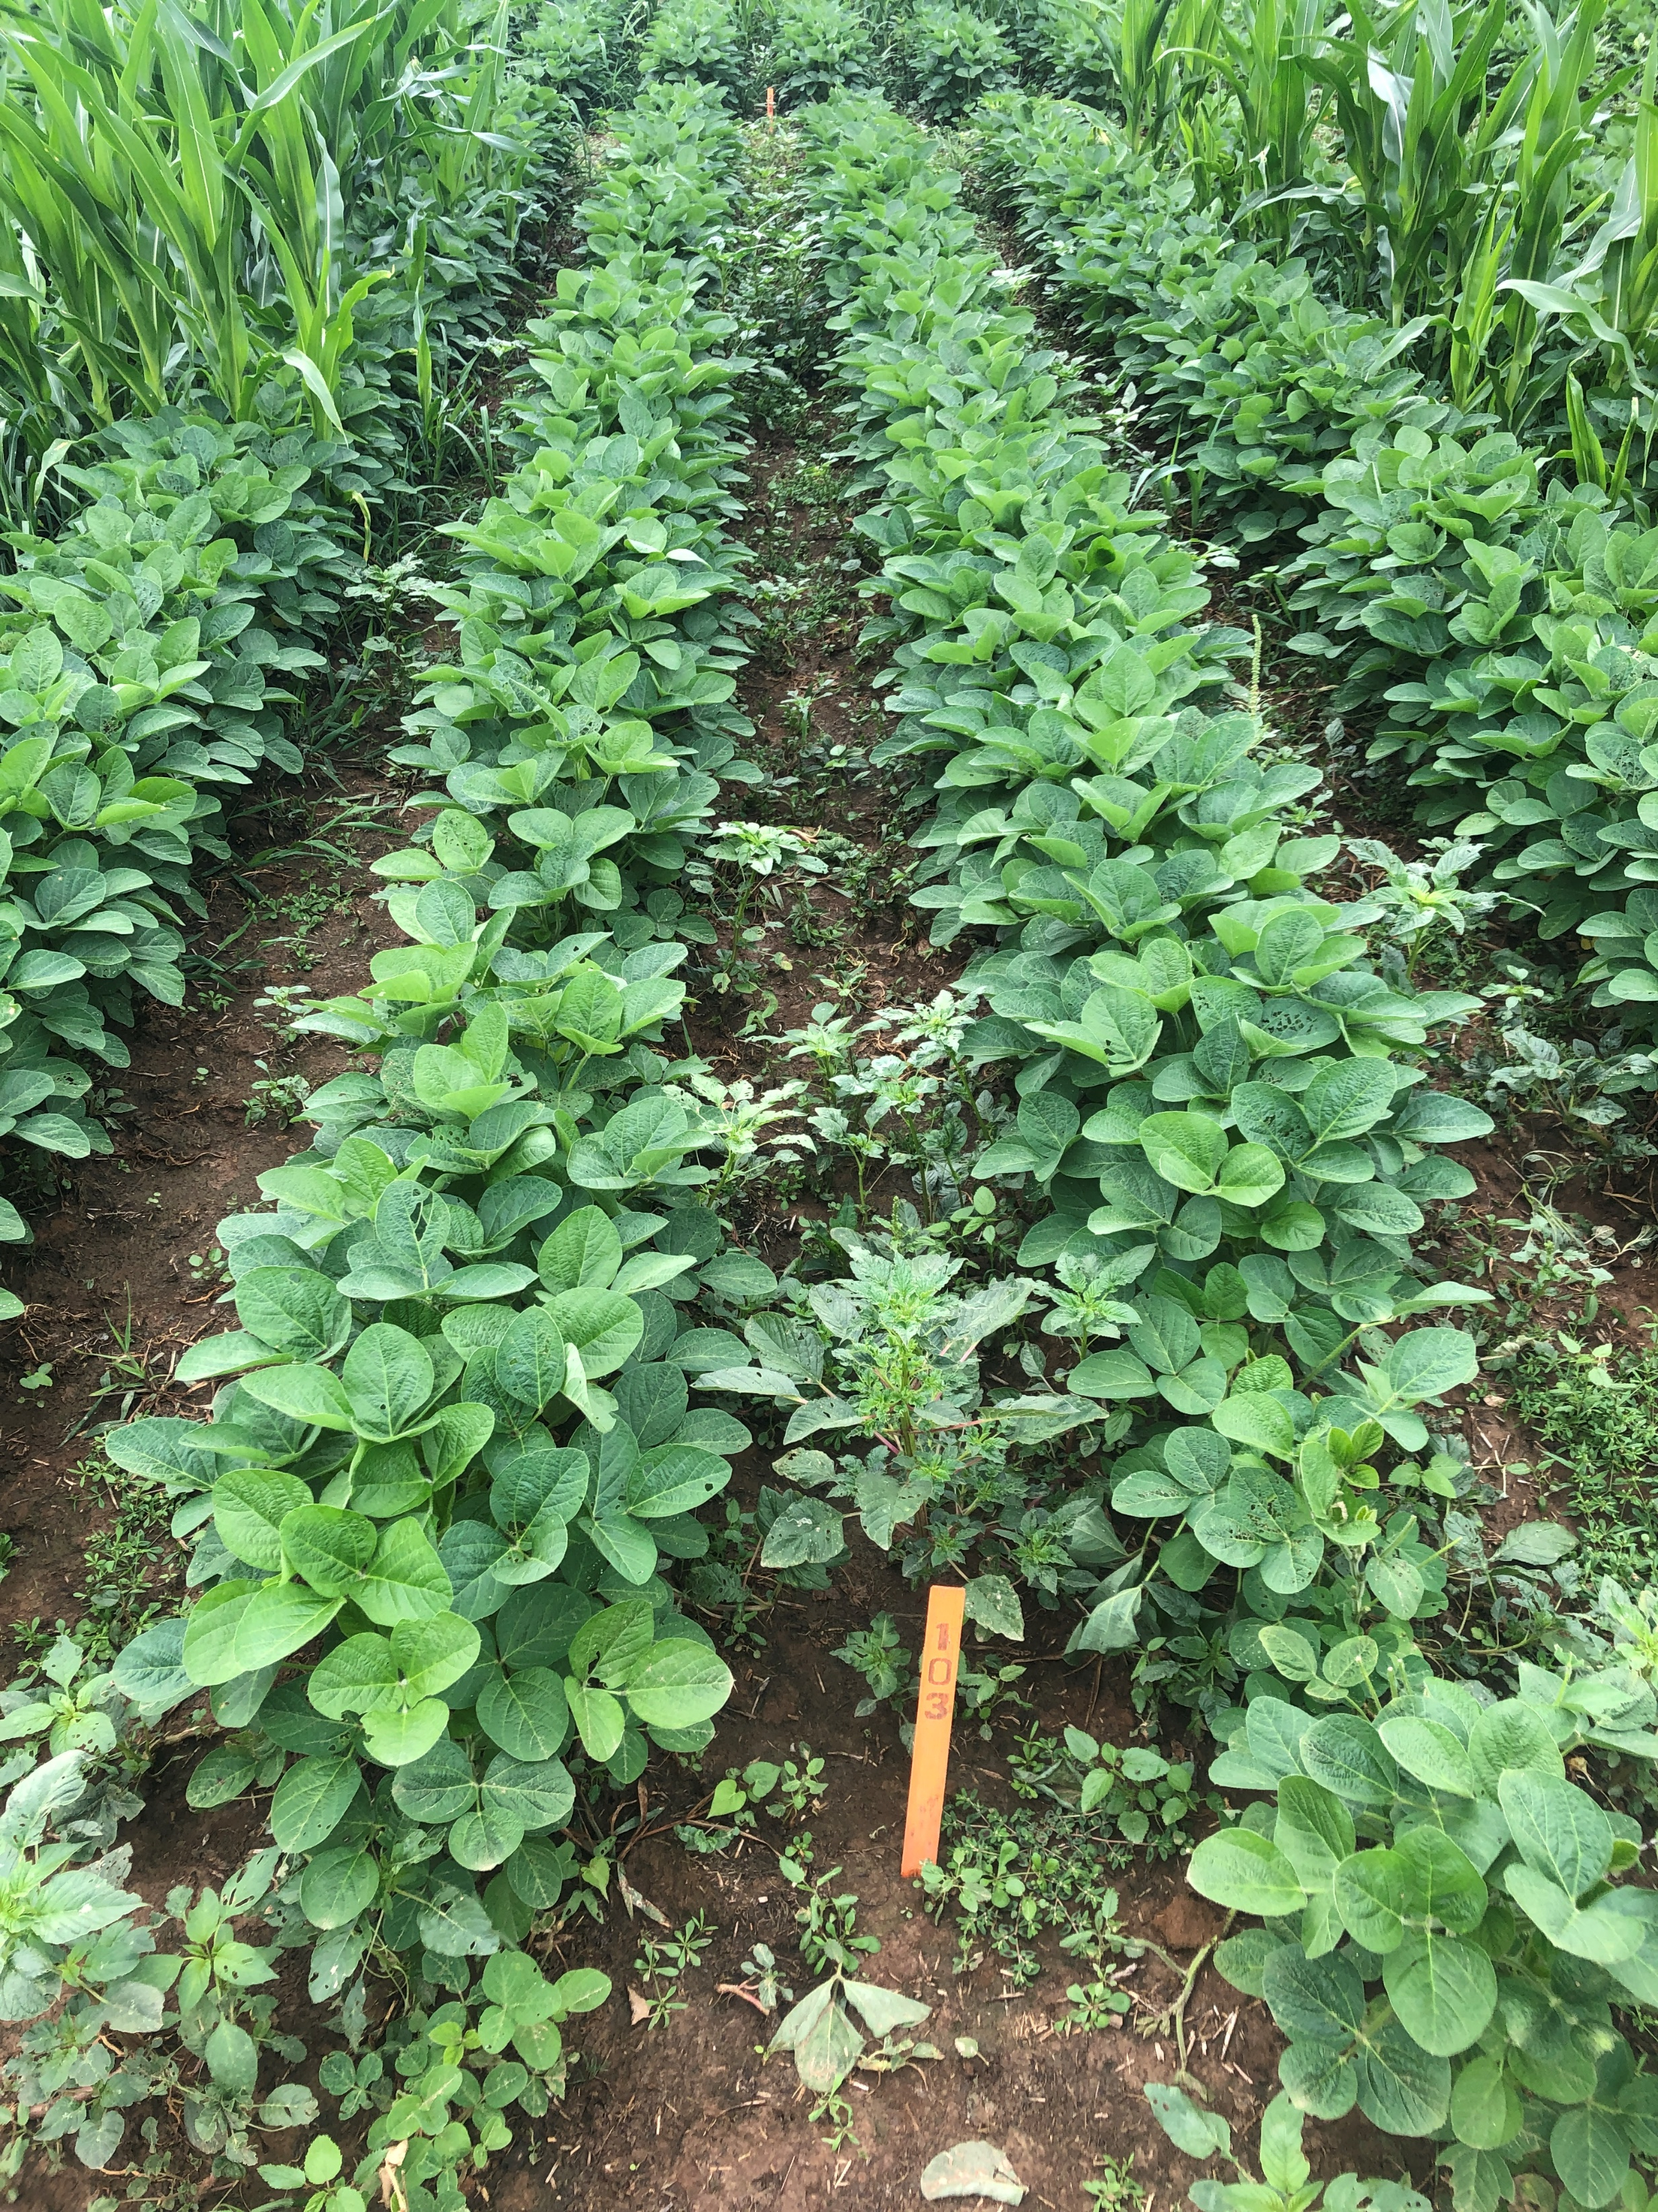
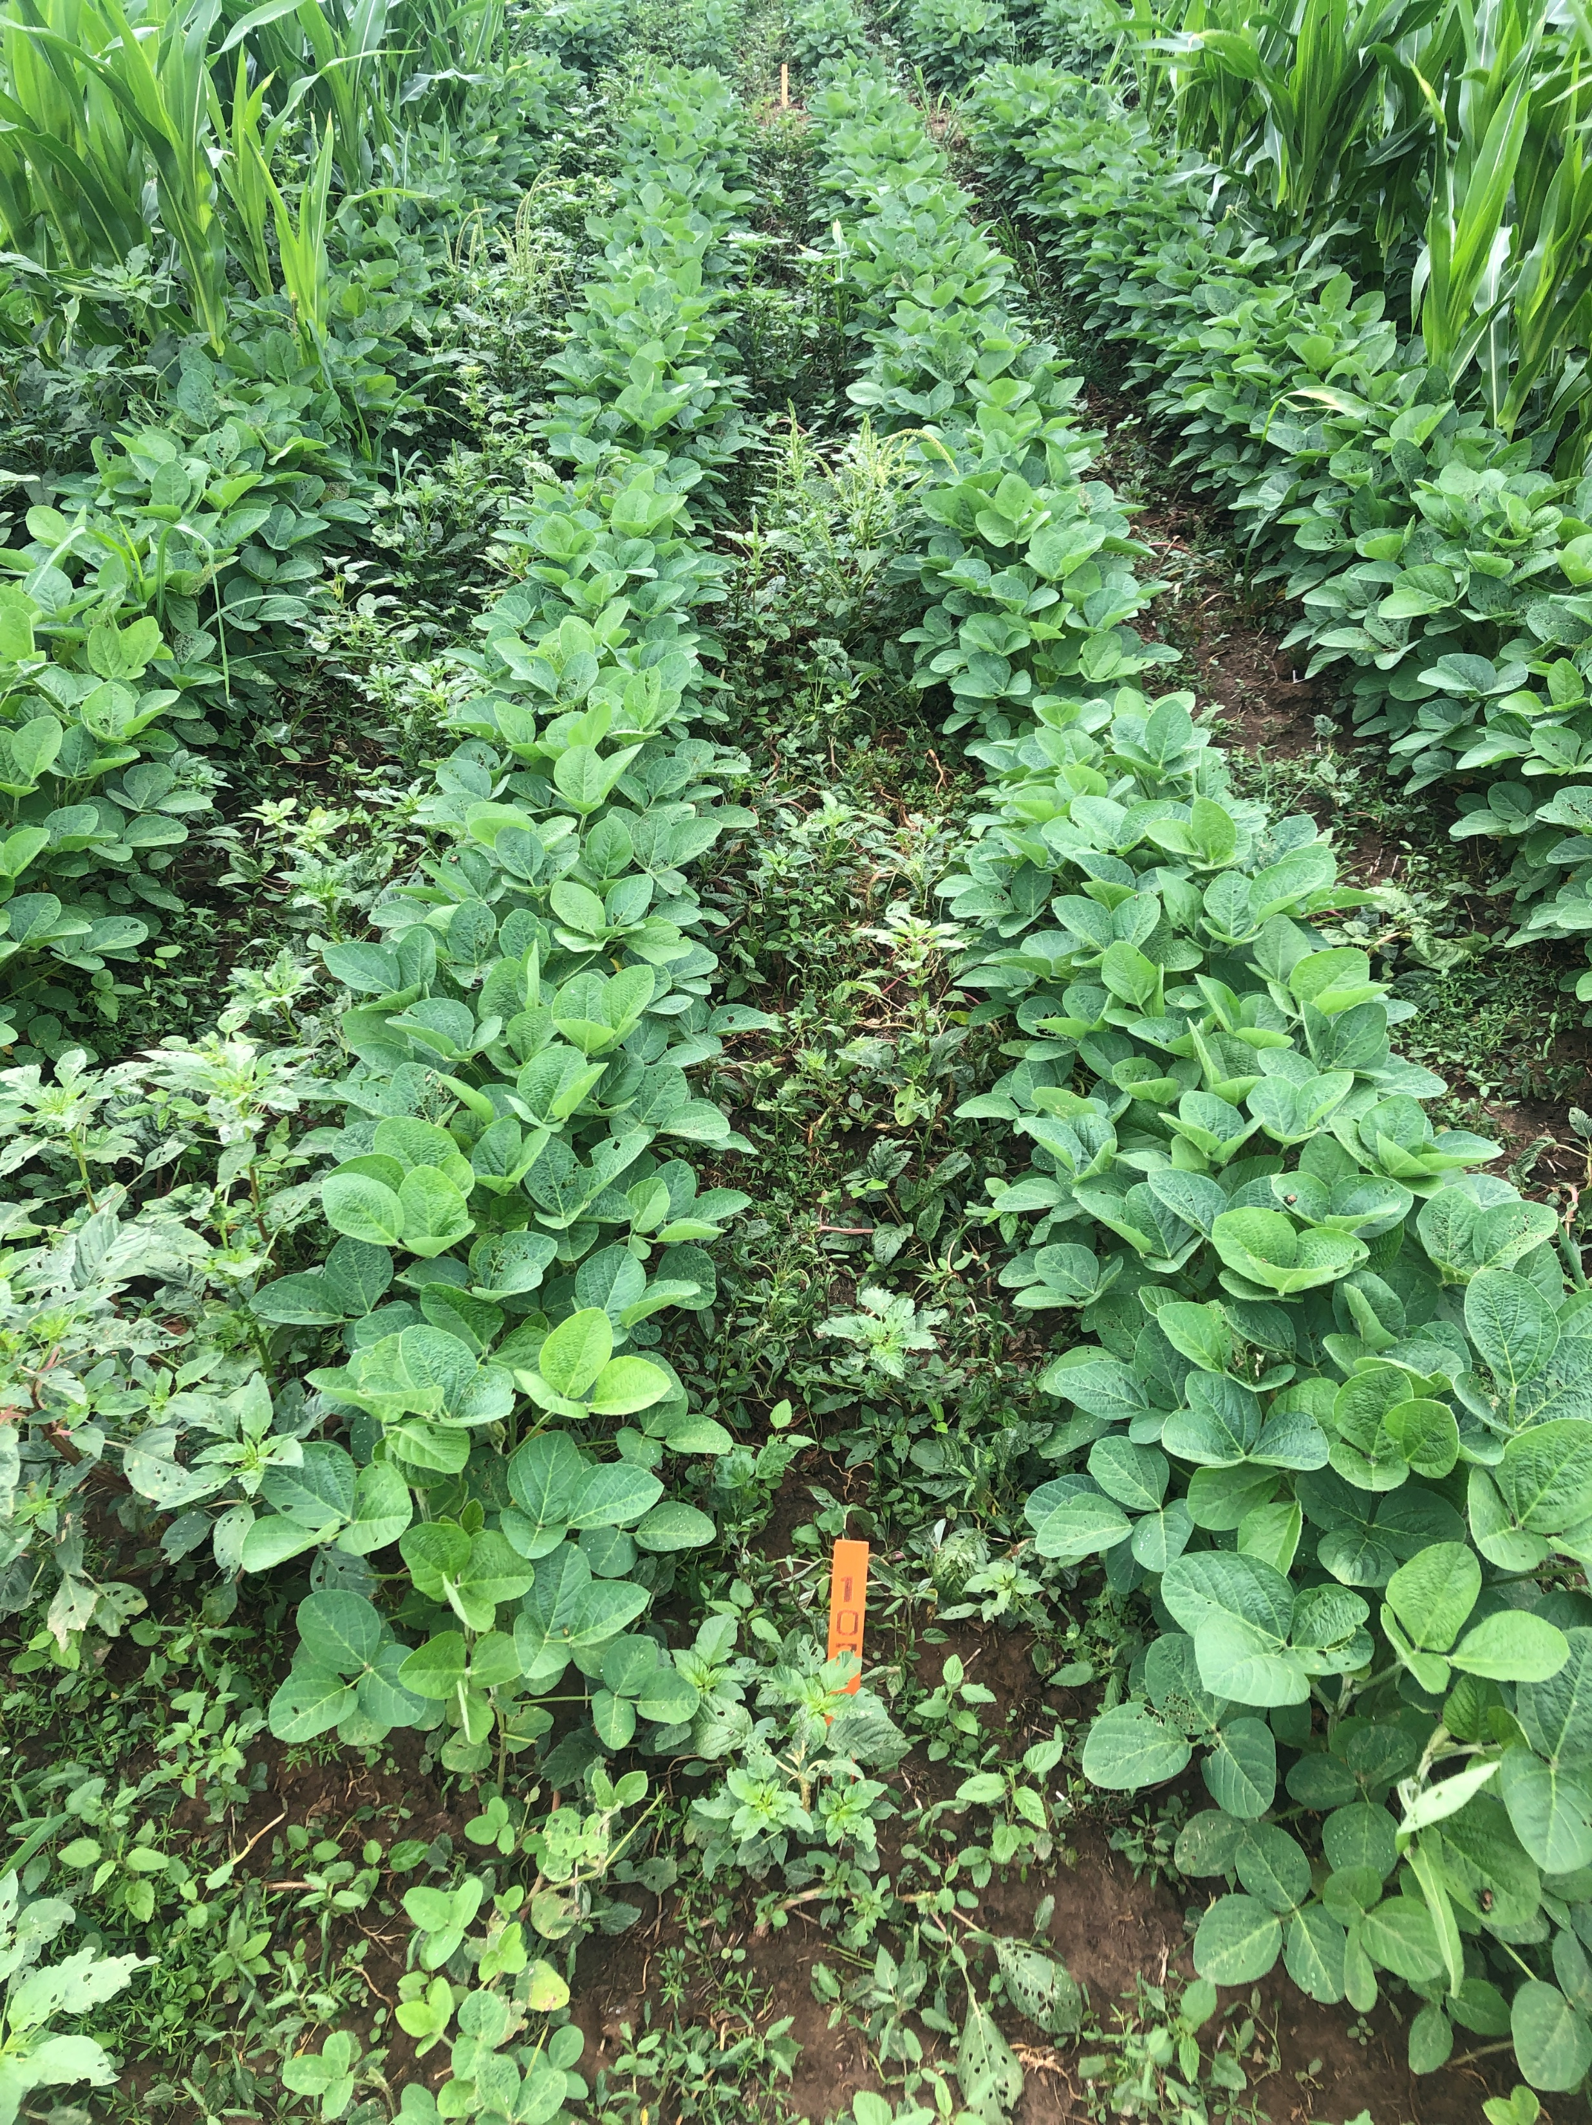
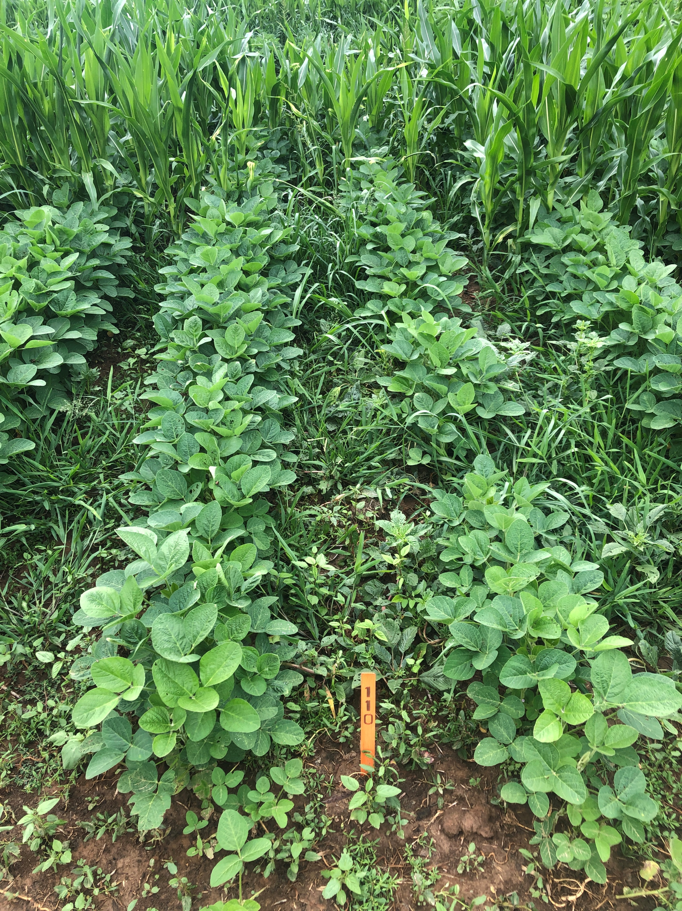
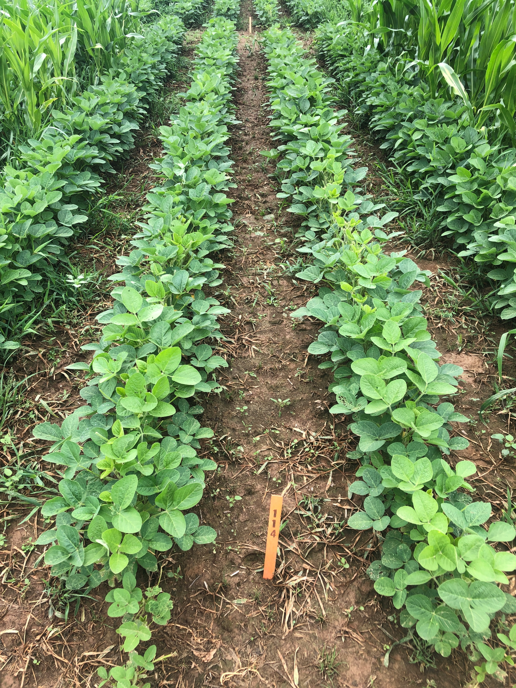
TN – 21 DAA
200 EC 50 g
250 EC 50 g
500 SC 50 g
SelectMax 100 g

Slide 39
Results: 7 DAA – Annual grass control
 |  | BRAPP | DIGSA | ELEIN | SETPU | Grand
 |  | TN | KS | TN | KS | Average
Trt Num | Best Trt Label | - | - | - | -
1 | Check | 0 | 0 | 0 | 0 | 0
2 | EXF17381E 200EC 25 g + COC 1% + AMS 2.5% | 81 | 68 | 81 | 75 | 76
3 | EXF17381E 200EC 50 g + COC 1% + AMS 2.5% | 91 | 82 | 91 | 90 | 88
4 | EXF17381E 200EC 75 g + COC 1% + AMS 2.5% | 87 | 93 | 87 | 95 | 91
5 | EXF17381E 200EC 100 g + COC 1% + AMS 2.5% | 91 | 95 | 91 | 97 | 93
6 | EXF19214J 250EC 25 g + COC 1% + AMS 2.5% | 83 | 85 | 83 | 88 | 85
7 | EXF19214J 250EC 50 g + COC 1% + AMS 2.5% | 86 | 80 | 86 | 93 | 86
8 | EXF19214J 250EC 75 g + COC 1% + AMS 2.5% | 92 | 83 | 92 | 92 | 90
9 | EXF19214J 250EC 100 g + COC 1% + AMS 2.5% | 93 | 90 | 93 | 92 | 92
10 | EXF18546H 500SC 25 g + COC 1% + AMS 2.5% | 48 | 30 | 48 | 43 | 42
11 | EXF18546H 500SC 50 g + COC 1% + AMS 2.5% | 53 | 42 | 53 | 57 | 51
12 | EXF18546H 500SC 75 g + COC 1% + AMS 2.5% | 58 | 45 | 58 | 58 | 55
13 | EXF18546H 500SC 100 g + COC 1% + AMS 2.5% | 43 | 50 | 43 | 38 | 44
14 | Select Max 100 g + COC 1% + AMS 2.5% | 90 | 88 | 90 | 85 | 88

Slide 40
Results: 14 DAA – Annual grass control

Slide 41
Results: 28 DAA – Annual grass control
 |  | BRAPP | DIGSA |  | ELEIN | PANDI | SETFA |  | SETPU | Grand
 |  | TN | KS | MD | TN | IA | IA | MD | KS | Average
Trt Num | Best Trt Label | - | - | - | - | - | - | - | -
1 | Check | 0 | 0 | 0 | 0 | 0 | 0 | 0 | 0 | 0
2 | EXF17381E 200EC 25 g + COC 1% + AMS 2.5% | 97 | 92 | 82 | 95 | 65 | 62 | 72 | 75 | 80
3 | EXF17381E 200EC 50 g + COC 1% + AMS 2.5% | 98 | 98 | 95 | 98 | 93 | 85 | 93 | 95 | 94
4 | EXF17381E 200EC 75 g + COC 1% + AMS 2.5% | 99 | 100 | 100 | 100 | 90 | 88 | 100 | 98 | 97
5 | EXF17381E 200EC 100 g + COC 1% + AMS 2.5% | 100 | 100 | 100 | 100 | 100 | 90 | 100 | 98 | 98
6 | EXF19214J 250EC 25 g + COC 1% + AMS 2.5% | 99 | 90 | 90 | 99 | 87 | 64 | 83 | 90 | 88
7 | EXF19214J 250EC 50 g + COC 1% + AMS 2.5% | 100 | 97 | 100 | 100 | 92 | 85 | 100 | 94 | 96
8 | EXF19214J 250EC 75 g + COC 1% + AMS 2.5% | 100 | 99 | 100 | 100 | 95 | 91 | 100 | 95 | 98
9 | EXF19214J 250EC 100 g + COC 1% + AMS 2.5% | 100 | 98 | 100 | 100 | 93 | 89 | 97 | 97 | 97
10 | EXF18546H 500SC 25 g + COC 1% + AMS 2.5% | 3 | 18 | 65 | 3 | 43 | 30 | 58 | 38 | 32
11 | EXF18546H 500SC 50 g + COC 1% + AMS 2.5% | 32 | 73 | 68 | 32 | 48 | 42 | 63 | 53 | 52
12 | EXF18546H 500SC 75 g + COC 1% + AMS 2.5% | 38 | 53 | 62 | 38 | 73 | 55 | 62 | 47 | 53
13 | EXF18546H 500SC 100 g + COC 1% + AMS 2.5% | 37 | 43 | 50 | 40 | 43 | 45 | 52 | 63 | 47
14 | Select Max 100 g + COC 1% + AMS 2.5% | 98 | 97 | 100 | 99 | 98 | 97 | 100 | 97 | 98

Slide 42
Results: 42 DAA – Annual grass control
 |  | DIGSA |  | SETFA |  | SETPU | Grand
 |  | KS | MD | IA | MD | KS | Average
Trt Num | Best Trt Label | - | - | - | - | -
1 | Check | 0 | 0 | 0 | 0 | 0 | 0
2 | EXF17381E 200EC 25 g + COC 1% + AMS 2.5% | 90 | 80 | 55 | 50 | 77 | 70
3 | EXF17381E 200EC 50 g + COC 1% + AMS 2.5% | 98 | 95 | 73 | 87 | 92 | 89
4 | EXF17381E 200EC 75 g + COC 1% + AMS 2.5% | 100 | 97 | 83 | 93 | 98 | 94
5 | EXF17381E 200EC 100 g + COC 1% + AMS 2.5% | 100 | 100 | 81 | 98 | 97 | 95
6 | EXF19214J 250EC 25 g + COC 1% + AMS 2.5% | 85 | 85 | 47 | 70 | 87 | 75
7 | EXF19214J 250EC 50 g + COC 1% + AMS 2.5% | 95 | 100 | 73 | 100 | 92 | 92
8 | EXF19214J 250EC 75 g + COC 1% + AMS 2.5% | 100 | 100 | 80 | 97 | 94 | 94
9 | EXF19214J 250EC 100 g + COC 1% + AMS 2.5% | 98 | 100 | 79 | 97 | 97 | 94
10 | EXF18546H 500SC 25 g + COC 1% + AMS 2.5% | 7 | 52 | 23 | 30 | 27 | 28
11 | EXF18546H 500SC 50 g + COC 1% + AMS 2.5% | 62 | 57 | 30 | 40 | 50 | 48
12 | EXF18546H 500SC 75 g + COC 1% + AMS 2.5% | 50 | 50 | 37 | 37 | 38 | 42
13 | EXF18546H 500SC 100 g + COC 1% + AMS 2.5% | 43 | 33 | 32 | 28 | 62 | 40
14 | Select Max 100 g + COC 1% + AMS 2.5% | 95 | 100 | 95 | 100 | 95 | 97

Slide 43
Results: Volunteer corn control 7 DAA: LLGT and Enlist
Conditional formatting is based on: RED < 80, YELLOW < 90, GREEN => 90

Slide 44
Results: Volunteer corn control 14 DAA: LLGT and Enlist

Slide 45
Results: Volunteer corn control 28 DAA: LLGT and Enlist
 |  | ZEAMX |  |  |  |  |  | Grand
 |  | IA | KS |  | MD | TN |  | Average
Trt Num | Best Trt Label | ENLIST Volunteer | Mycogen MY12G36 Enlist | Pioneer 11197AMXT GT Corn | PIO1197AMXT | GLY-R, GLU-R, BT - NK1263-3111A | Enlist - MY08T22
1 | Check | 0 | 0 | 0 | 0 | 0 | 0 | 0
2 | EXF17381E 200EC 25 g + COC 1% + AMS 2.5% | 85 | 90 | 97 | 100 | 98 | 98 | 95
3 | EXF17381E 200EC 50 g + COC 1% + AMS 2.5% | 99 | 97 | 99 | 100 | 100 | 100 | 99
4 | EXF17381E 200EC 75 g + COC 1% + AMS 2.5% | 99 | 99 | 100 | 100 | 100 | 100 | 100
5 | EXF17381E 200EC 100 g + COC 1% + AMS 2.5% | 100 | 97 | 100 | 100 | 100 | 100 | 99
6 | EXF19214J 250EC 25 g + COC 1% + AMS 2.5% | 87 | 87 | 100 | 100 | 100 | 100 | 96
7 | EXF19214J 250EC 50 g + COC 1% + AMS 2.5% | 100 | 97 | 100 | 100 | 100 | 100 | 99
8 | EXF19214J 250EC 75 g + COC 1% + AMS 2.5% | 100 | 96 | 100 | 100 | 100 | 100 | 99
9 | EXF19214J 250EC 100 g + COC 1% + AMS 2.5% | 100 | 99 | 100 | 100 | 100 | 100 | 100
10 | EXF18546H 500SC 25 g + COC 1% + AMS 2.5% | 75 | 47 | 23 | 68 | 22 | 20 | 42
11 | EXF18546H 500SC 50 g + COC 1% + AMS 2.5% | 85 | 50 | 63 | 80 | 30 | 25 | 56
12 | EXF18546H 500SC 75 g + COC 1% + AMS 2.5% | 87 | 55 | 72 | 72 | 72 | 65 | 70
13 | EXF18546H 500SC 100 g + COC 1% + AMS 2.5% | 90 | 50 | 67 | 77 | 72 | 72 | 71
14 | Select Max 100 g + COC 1% + AMS 2.5% | 99 | 98 | 98 | 100 | 100 | 100 | 99

Slide 46
Results: Volunteer corn control 42 DAA: LLGT and Enlist
 |  | ZEAMX |  |  |  | Grand
 |  | IA | KS |  | MD | Average
Trt Num | Best Trt Label | ENLIST Volunteer | Mycogen MY12G36 Enlist | Pioneer 11197AMXT GT Corn | PIO1197AMXT
1 | Check | 0 | 0 | 0 | 0 | 0
2 | EXF17381E 200EC 25 g + COC 1% + AMS 2.5% | 83 | 87 | 98 | 100 | 92
3 | EXF17381E 200EC 50 g + COC 1% + AMS 2.5% | 99 | 98 | 100 | 100 | 99
4 | EXF17381E 200EC 75 g + COC 1% + AMS 2.5% | 99 | 100 | 100 | 100 | 100
5 | EXF17381E 200EC 100 g + COC 1% + AMS 2.5% | 100 | 98 | 100 | 100 | 100
6 | EXF19214J 250EC 25 g + COC 1% + AMS 2.5% | 78 | 87 | 100 | 100 | 91
7 | EXF19214J 250EC 50 g + COC 1% + AMS 2.5% | 96 | 98 | 100 | 100 | 98
8 | EXF19214J 250EC 75 g + COC 1% + AMS 2.5% | 98 | 97 | 100 | 100 | 99
9 | EXF19214J 250EC 100 g + COC 1% + AMS 2.5% | 99 | 100 | 100 | 100 | 100
10 | EXF18546H 500SC 25 g + COC 1% + AMS 2.5% | 67 | 40 | 25 | 53 | 46
11 | EXF18546H 500SC 50 g + COC 1% + AMS 2.5% | 77 | 50 | 67 | 67 | 65
12 | EXF18546H 500SC 75 g + COC 1% + AMS 2.5% | 67 | 50 | 67 | 65 | 62
13 | EXF18546H 500SC 100 g + COC 1% + AMS 2.5% | 78 | 50 | 68 | 77 | 68
14 | Select Max 100 g + COC 1% + AMS 2.5% | 91 | 100 | 100 | 100 | 98

Slide 47
Soybean Max Phyto
 |  | GLXMA
 |  | NK S37-A4X Xtend | S25-V8X | S39G2X | S46-E3
 |  | KS | IA | MD | TN
Trt Num | Best Trt Label | GLY-R, AUX-R | Xtend Dicamba | - | GLY-R, GLU-R, AUX-R
1 | Check | 0 | 0 | 0 | 0
2 | EXF17381E 200EC 25 g + COC 1% + AMS 2.5% | 0 | 0 | 0 | 4
3 | EXF17381E 200EC 50 g + COC 1% + AMS 2.5% | 0 | 0 | 0 | 2
4 | EXF17381E 200EC 75 g + COC 1% + AMS 2.5% | 0 | 0 | 0 | 6
5 | EXF17381E 200EC 100 g + COC 1% + AMS 2.5% | 0 | 0 | 0 | 2
6 | EXF19214J 250EC 25 g + COC 1% + AMS 2.5% | 0 | 0 | 0 | 2
7 | EXF19214J 250EC 50 g + COC 1% + AMS 2.5% | 0 | 0 | 0 | 2
8 | EXF19214J 250EC 75 g + COC 1% + AMS 2.5% | 0 | 0 | 0 | 2
9 | EXF19214J 250EC 100 g + COC 1% + AMS 2.5% | 0 | 0 | 0 | 2
10 | EXF18546H 500SC 25 g + COC 1% + AMS 2.5% | 0 | 0 | 0 | 3
11 | EXF18546H 500SC 50 g + COC 1% + AMS 2.5% | 0 | 0 | 0 | 2
12 | EXF18546H 500SC 75 g + COC 1% + AMS 2.5% | 0 | 0 | 0 | 2
13 | EXF18546H 500SC 100 g + COC 1% + AMS 2.5% | 0 | 0 | 0 | 2
14 | Select Max 100 g + COC 1% + AMS 2.5% | 0 | 1 | 0 | 3

Slide 48
Summary: Objectives answered & additional conclusions/observations
Determine the optimum SYN550023 rate for each formulation that will provide acceptable control, (90% or >), of key grasses LPOST; Acceptable Volunteer corn control is => than the standard
SYN550023 200 EC – 50 g for annual grass, (BRAPP, DIGSA, ELEIN, PANDI, SETFA, SETPU), 94% on average and 25 g for RRLL and 50 g for Enlist Volunteer corn, 98% or greater
SYN550023 250 EC – 50 g for annual grass, (BRAPP, DIGSA, ELEIN, PANDI, SETFA, SETPU), 96% on average, 25 g for RRLL Volunteer corn, 99% and 50 g for Enlist Volunteer corn, 99%
SYN550023 500 SC – no rate tested was high enough for commercial control of annual grasses or volunteer corn

Slide 49
Summary: Objectives answered & additional conclusions/observations
Determine the best SYN550023 formulation for grass efficacy and crop selectivity
SYN550023 200 or 250 EC were equivalent
Soybean phyto was minimal across all treatments and rates with 6% being the max injury noted at any location
How does SYN550023 compare to the standard clethodim for controlling larger grasses?
SYN550023 200 or 250 EC is as good as the commercial standard of Select Max at half the rate

Slide 50
Recommendations:
Promote SYN550023 200 and/or 250 EC for control of Volunteer corn and annual grasses at rates as low as 25 g

